Slide 1


AIBridge
Lecture 2
Notes:
Hello everybody! Welcome back to lecture 2. (click)

Slide 2
Lecture Outline
I/O
List Manipulation
Functions
Notes:
In this lecture, we will be covering two main things: input and output, and list manipulation. Don’t think you got off easy yet with just these two topics, as these are some quite complicated and tough topics. Let’s dive on in.

Slide 3
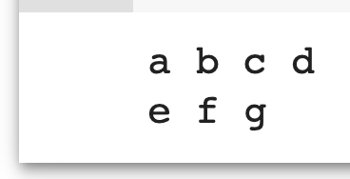
I/O
Standard Output
Output to Console: print(object1, object2, ...)
print('a', 'b', 'c', 'd')
print('e', 'f', 'g')
Notes:
Last lecture we learned about variables, which is a value stored in a name. If we want to know about which value is currently stored in that variable, we can use `print` to output it to what’s called the “console.” The console is basically a bridge between our code and the user. This is the simplest way to access information currently in our code.

Slide 4
I/O
Standard Input
Input from Console: input('prompt')
x = input('Please think of a month')
print(x)
Notes:
Similarly, if we want gather information from a user, we can use the `input`, which will collect information from via the console. Demo However, if we need a lot of information to input or output, for example we have millions of data that we’d like to process, and then output the results, doing this manually via the console be would not be feasible

Slide 5
I/O
File I/O
# input from file
with open(file_name, 'r') as f:
lines = f.readlines()
# write to file
with open(file_name, ‘w') as f:
f.write(content)
Notes:
First, we can take input from what’s called the “console.” On Google Colab, the console is right below a cell where code runs, with this type of input being taken there. However, the location of the console is different for each environment, so just be aware of that. Let’s go over to Google Colab to test this out! (stretch boundary so that Colab is larger) (demonstrate over in Colab) Now, we don’t always want to be inputting like this into our code. Imagine doing that for thousands or even millions of numbers. Even with copying and pasting, that would be quite tedious. So how should we do this? Well, we can use python to read from a file. (click) Now we would want to use files because they’re commonly how data is stored. For example, you might want to get data from an xlsx spreadsheet for your code. In Python, we read from a file using the (click) “open” function. You also need to declare which mode you want to access the file in, which in this case, is (click) read mode. What the “file” refers to here is the path to the file, and we’ll get into that in a moment. There are several ways to read out of the fileFirst, we can use the (click) read function. This

Slide 6
List Manipulation
Indexing
List Operations
List Comprehension
String/list Interop
Multidimensional Lists

Slide 7
List Manipulation
Indexing
[a, b, c, d, e]
0 1 2 3 4
-5 -4 -3 -2 -1
Single indexing
i
0
3
1
list_name[ ]
list_name[-2]
List slicing
list_name[ : ]
i j
1 4
Notes:
Clarify that slices work through the ENTIRE array subsection
Mention that it works with strings too

Slide 8
Self-Test
List Manipulation
Indexing
arr = [4, 5, 6, 101, 102, 103, 104, 105]
new_arr = arr[2:6]
print(new_arr)
What does the following code output?
A. [5, 6, 7, 101, 102, 103, 104, 105]
B. [6, 7, 101, 102, 103, 104, 105]
C. [6, 101, 102, 103, 104]
D. [6, 101, 102, 103]

Slide 9
List Manipulation
Indexing
List Operations
List Comprehension
String/list Interop
Multidimensional Lists

Slide 10

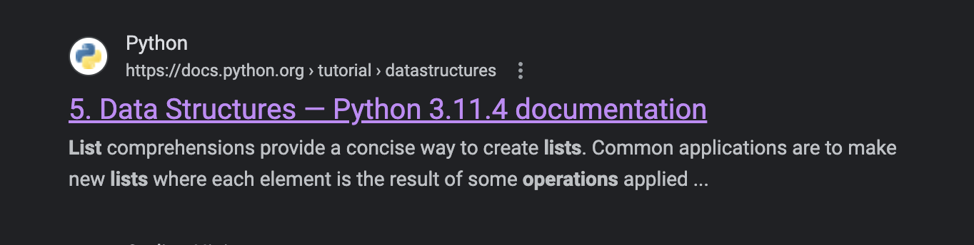
List Manipulation
List Operations
https://docs.python.org/3/tutorial/datastructures.html
1
2
Notes:
Switch over to Colab to demonstrate code reading
Mention no need to memorize these

Slide 11
List Manipulation
List Operations
my_list =
[3, 14, 0, -2, 5
]

Slide 12
List Manipulation
List Operations
append()
[3, 14, 0, -2, 5
]
my_list.append(19)
19

Slide 13
List Manipulation
List Operations
append()
[3, 14, 0, -2, 5, 19
,
19
[3, 14, 0, -2, 5
]
my_list.append(19)
8
my_list.append( )
my_list.append(8)

Slide 14
List Manipulation
List Operations
append()
[3, 14, 0, -2, 5, 19
[3, 14, 0, -2, 5, 19, 8]
,
8
]
my_list.append(19)
my_list.append(8)

Slide 15
List Manipulation
List Operations
remove()
-2,
5, 19, 8]
[3, 14, 0, -2, 5, 19, 8]
[3, 14, 0,
my_list.remove(-2)

Slide 16
List Manipulation
List Operations
remove()
5, 19, 8]
[3, 14, 0, 5,
19,
8]
[3, 14, 0,
my_list.remove(-2)
my_list.remove(19)

Slide 17
List Manipulation
List Operations
remove()
[3, 14, 0, 5,
[3, 14, 0, 5, 8]
8]
my_list.remove(-2)
my_list.remove(19)

Slide 18
List Manipulation
List Operations
insert()
[3, 14, 0,
5, 8]
[3, 14, 0, 5, 8]
my_list.insert(3, 14)

Slide 19
List Manipulation
List Operations
insert()
[3, 14, 0,
14,
5, 8]
my_list.insert(3, 14)
my_list.insert(3, 1)

Slide 20
List Manipulation
List Operations
insert()
[3, 14, 0,
1,
14, 5, 8]
14,
5, 8]
my_list.insert(3, 14)
my_list.insert(3, 1)

Slide 21
List Manipulation
List Operations
pop()
1
,
14, 5, 8]
[3, 14, 0,
1,
my_list.pop(3)

Slide 22
List Manipulation
List Operations
pop()
[3, 14, 0,
14
,
5, 8]
14, 5, 8]
1
my_list.pop(3)
my_list.pop(3)

Slide 23
List Manipulation
List Operations
pop()
[3, 14, 0, 5, 8]
[3, 14, 0,
5, 8]
1
my_list.pop(3)
my_list.pop(3)
14

Slide 24
List Manipulation
List Operations
+
]
[3, 14, 0, 5, 8
[3, 14, 0, 5, 8]
my_list_2 = [10, 9, 8, 7]
my_list_2 = [
10, 9, 8, 7]
my_list = my_list + my_list_2

Slide 25
List Manipulation
List Operations
+
[3, 14, 0, 5, 8
10, 9, 8, 7]
,
my_list_2 = [10, 9, 8, 7]
my_list = my_list + my_list_2

Slide 26
List Manipulation
List Operations
sort()
9,
7
10, 9, 8, 7]
,
0,
8,
10,
8,
]
[3, 14, 0, 5, 8
[
3,
14
5,
,
my_list.sort()

Slide 27
List Manipulation
List Operations
sort()
[
3,
5,
7
]
0,
,
8,
10,
[0, 3, 5, 7, 8, 8, 9, 10, 14]
8,
9,
14
my_list.sort()

Slide 28
List Manipulation
List Operations
len()
[0, 3, 5, 7, 8, 8, 9, 10, 14]
len(my_list)
9

Slide 29
List Manipulation
List Operations
max()
[0, 3, 5, 7, 8, 8, 9, 10, 14]
max(my_list)
14

Slide 30
List Manipulation
List Operations
min()
[0, 3, 5, 7, 8, 8, 9, 10, 14]
min(my_list)
0

Slide 31
List Manipulation
Indexing
List Operations
List Comprehension
String/list Interop
Multidimensional Lists

Slide 32
List Manipulation
List Comprehension
Shorthand for “for” loops
new_list = [expression for object in iteration]
[obj1, obj2, obj3, obj4, obj5, obj6, obj7 ...]
[new1, new2, new3, new4, new5, new6, new7 ...]
expression
Notes:
For even cleaner code that uses less lines, you can consider using list comprehension. Usually, you want to use them when you generate a new list based on an existing list, string, or range

Slide 33
List Manipulation
List Comprehension
new_list = [(i+1)/2 for i in range(7)]
[0, 1, 2, 3, 4, 5, 6]
[0.5, 1.0, 1.5, 2.0, 2.5, 3.0, 3.5]
(i+1)/2
Notes:
For even cleaner code that uses less lines, you can consider using list comprehension. Usually, you want to use them when you generate a new list based on an existing list, string, or range

Slide 34
List Manipulation
List Comprehension
even_nums = [x for x in range(7) if x % 2 == 0]
[0, 1, 2, 3, 4, 5, 6]
[0, 2, 4, 6]
Notes:
For even cleaner code that uses less lines, you can consider using list comprehension. Usually, you want to use them when you generate a new list based on an existing list, string, or range

Slide 35
List Manipulation
Indexing
List Operations
List Comprehension
String/list Interop
Multidimensional Lists

Slide 36
List Manipulation
String/list Interop
join()
List of strings
str3
my_list = [str1, str2, str3]
str1
str2
separator
separator
separator.join(my_list)

Slide 37
List Manipulation
String/list Interop
join()
List of strings
my_list = [str1, str2, str3]
separator.join(my_list)
Final String
str1
separator
str2
separator
str3

Slide 38
List Manipulation
String/list Interop
join()
"Hello,"
"my"
"name"
"is"
"Bob!"
my_list = ["Hello,", "my", "name", "is", "Bob!"]
' '
' '.join(my_list)
' '
' '
' '

Slide 39
List Manipulation
String/list Interop
join()
my_list = ["Hello,", "my", "name", "is", "Bob!"]
' '.join(my_list)
' '
' '
' '
"my"
"name"
"is"
"Bob!"
"Hello, my name is Bob!"
' '
"Hello,"

Slide 40
List Manipulation
Indexing
List Operations
List Comprehension
String/list Interop
Multidimensional Lists

Slide 41

List Manipulation
Multidimensional Lists
A list inside a list [inside a list inside …]
Always has been
Wait, it’s all lists?

Slide 42
List Manipulation
Multidimensional Lists
A list inside a list [inside a list inside …]
my_list
[[1, 2, 3],
[4, 5, 6],
[7, 8, 9]]
i
1
0
2
my_list[ ]
j
2
0
1
my_list[ ][ ]
0
i
1
2

Slide 43
Functions

Slide 44
Lecture Outline
What is a function?
Built-ins
Importing
Function defining

Slide 45
What is a function?
Function
Input
Output

Slide 46
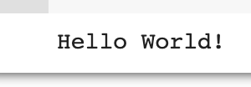
What is a function?
print()
Print
"Hello world!"

Slide 47
Lecture Outline
What is a function?
Built-ins
Importing
Function defining

Slide 48

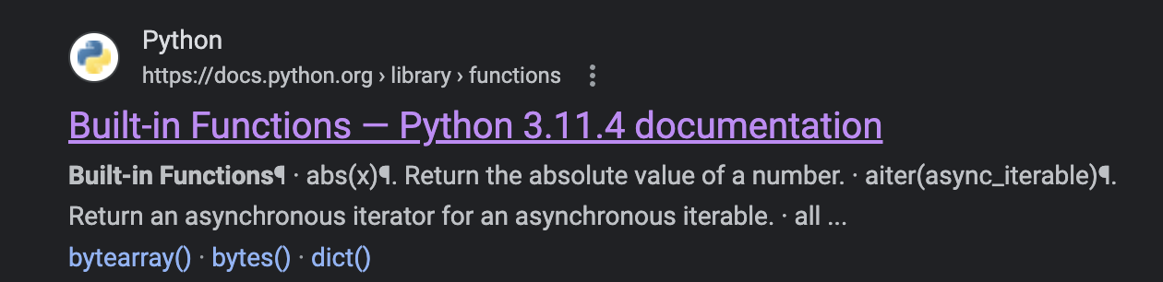
Built-ins
https://docs.python.org/3/library/functions.html
1
2
Notes:
Standard input and output formats vary with compiler.
Emphasize that you have to close file

Slide 49
Lecture Outline
What is a function?
Built-ins
Importing
Function defining

Slide 50
Importing
Burp
Python
Module
Notes:
Importing is particularly important because we don’t want to reinvent the wheel. Other people have already heavily optimized and published modules and functions and we can build up from that foundation. The general syntax for importing is…

Slide 51
Importing
import sklearn
from sklearn import linear_model
import sklearn as skl
Notes:
Importing is particularly important because we don’t want to reinvent the wheel. Other people have already heavily optimized and published modules and functions and we can build up from that foundation. The general syntax for importing is…

Slide 52
Lecture Outline
What is a function?
Built-ins
Importing
Function defining

Slide 53
Function defining
Arguments passed
def function_name(arg1, arg2, ...):
# do stuff here
Notes:
Importing is particularly important because we don’t want to reinvent the wheel. Other people have already heavily optimized and published modules and functions and we can build up from that foundation. The general syntax for importing is…

Slide 54
Function defining
Arguments passed
return
def function_name(arg1, arg2, ...):
# do stuff here
return data
Notes:
Importing is particularly important because we don’t want to reinvent the wheel. Other people have already heavily optimized and published modules and functions and we can build up from that foundation. The general syntax for importing is…

Slide 55
Function defining
return
n=
def factorial(n):
total = 1
for i in range(1, n+1):
total *= i
return total
120
(=120)
# some code later
factorial(5)
5
Notes:
Importing is particularly important because we don’t want to reinvent the wheel. Other people have already heavily optimized and published modules and functions and we can build up from that foundation. The general syntax for importing is…

Slide 56
Function defining
return
def factorial(n):
total = 1
for i in range(1, n+1):
total *= i
return total
120
(=120)
# some code later
factorial(n=5)
n=5
An alternative…
Notes:
Importing is particularly important because we don’t want to reinvent the wheel. Other people have already heavily optimized and published modules and functions and we can build up from that foundation. The general syntax for importing is…

Slide 57
Function defining
Assumes default
Default
def factorial(n=6):
total = 1
for i in range(1, n+1):
total *= i
return total
720
(=720)
# some code later
factorial()
Notes:
Importing is particularly important because we don’t want to reinvent the wheel. Other people have already heavily optimized and published modules and functions and we can build up from that foundation. The general syntax for importing is…

Slide 58
That was a lot!
Let’s get to the lab!
Notes:
Let’s get to the lab

